Slide 1
ESTIMATION OF REMAINING USEFUL LIFE OF TURBOFAN ENGINE
PRESENTED BY
Name : BHAVANI BHATT
Roll No. : 18RE61D06

Slide 2

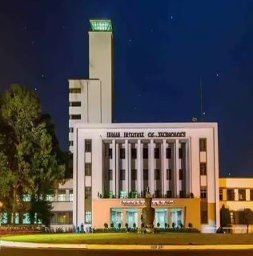
CONTENT
Subir Chowdhury School of Quality and Reliability
OBJECTIVE
VIEW OF ENGINE SIMULATED IN C-MAPSS
BLOCK DIAGRAM OF TURBOFAN ENGINE
C-MAPSS INPUTS TO SIMULATE SYSTEM
C-MAPSS OUTPUTS TO MEASURE SYSTEM RESPONSE
POSITIONS OF SENSORS
DESCRIPTION OF SENSORS

Slide 3
AIM
Subir Chowdhury School of Quality and Reliability
To estimate the Remaining Useful Life (RUL) of Turbofan Engine used in commercial aircraft using data driven methodology.

Slide 4

WORKING OF TURBOFAN ENGINE
Subir Chowdhury School of Quality and Reliability

Slide 5
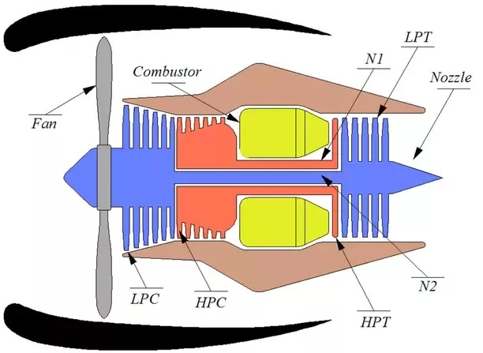
SYSTEM DESCRIPTION
Subir Chowdhury School of Quality and Reliability

Slide 6
BLOCK DIAGRAM OF TURBOFAN
ENGINE
Subir Chowdhury School of Quality and Reliability
AMBIENT
INLET
FAN
SPLITTER
LPC
BYPASS PATH
FUEL
HPC
BYPASS NOZZLE
BURNER
LPT
HPT
CORE NOZZLE

Slide 7
METHODOLOGIES OF RUL ESTIMATION
Subir Chowdhury School of Quality and Reliability
RUL Estimation Methodologies
Data Driven
Hybrid Model
Physics Based
Machine Learning model
Statistics Based

Slide 8
PHM CHALLENGE ?
Subir Chowdhury School of Quality and Reliability
Both Data Driven methods, Physics based methods and hybrid methods have shown advantages.
Bottleneck for data-driven method was the lack of availability of run-to-failure data.
Prognostic Data Repository was created. Data sets have been donated to the repository by various companies, universities, agencies etc.
PHM society is hosting challenges since 2008 for establishing new benchmarks and improvements in the field.

Slide 9
PHM CHALLENGE ?
Subir Chowdhury School of Quality and Reliability
Lack of common data set imposes restriction on developing and comparing the PHM approaches.
Prognostic Data Repository was created. Data sets have been donated to the repository by various companies, universities, agencies etc.
PHM society is formed for the sole purpose of promoting advancement in the PHM.
PHM society is hosting challenges since 2008 for establishing new benchmarks and improvements in the field.

Slide 10
WHY SIMULATED DATA ?
Subir Chowdhury School of Quality and Reliability
Procuring actual system fault progression data is time consuming and expensive.
Commercial Competition and military secret poses restrictions on sharing the data.
Proprietary constraints associated with sharing of fault evolution data also exist.
Lot of interferences from the outside environment are mixed into the monitoring data, thus decreasing the quality of the data and result calculated.

Slide 11
WHY SIMULATED DATA ?
Subir Chowdhury School of Quality and Reliability
Procuring actual system fault progression data is time consuming and expensive.
Commercial Competition and military secret poses restrictions on sharing the data.
Fielded systems not properly instrumented for collection of relevant data.
Lot of interferences from the outside environment are mixed into the monitoring data, thus decreasing the quality of the data and result calculated.

Slide 12
Literature Review
Subir Chowdhury School of Quality and Reliability
Approaches used for solving this problem can be divided into 3 categories.
Category 1: Using functional mappings between set of inputs and Remaining Useful Life(RUL)
Category 2 : Functional mapping between health indicator(HI) and RUL
Category 3 : Similarity based matching

Slide 13
DESCRIPTION OF DATASET
Subir Chowdhury School of Quality and Reliability
Data Generated through simulation using thermo-dynamical simulation model(C-MAPSS). C-MAPSS stands for Commercial Modular Aero-Propulsion System Simulation.
Data obtained from NASA Repository.
Run to failure data of number of aircraft engines.
21 parameters out of 58 outputs utilized to measure system response under different health states and operational conditions.

Slide 14
DESCRIPTION OF DATASET
Subir Chowdhury School of Quality and Reliability
Dataset generated includes 5 subset. One subset was used for the PHM Challenge.
Each subset contains 26 columns, recording the unit number, time, three operational parameters and 21 output parameters.
Each subset is further divided into a training set and a testing set.
The dataset used for challenge depicts high pressure compressor degradation.

Slide 15
PROPERTIES OF DATASET
Subir Chowdhury School of Quality and Reliability
Each subset includes not less than 100 training and testing units. Hence ideal candidate for Data driven prognostic algorithms.
Dataset contains observations which were generated based on a time cycle. Therefore, it is a time varying multivariate data.
Dataset includes 6 different operational conditions depicting the complete life cycle of the engine.

Slide 16
PROPERTIES OF DATASET
Subir Chowdhury School of Quality and Reliability
Engine is operating normally at the start of each time series and develops a fault at some point during the series.
In training set, the fault grows in magnitude until system fails.
In test set, the test series ends some time prior to system failure.

Slide 17
C-MAPSS INPUT MODULES
Subir Chowdhury School of Quality and Reliability
S.NO | NAME | S.NO | NAME
1 | Fuel Flow | 8 | HPC Flow Modifier
2 | Fan Efficiency Modifier | 9 | HPC Pressure Ratio Modifier
3 | Fan Flow Modifier | 10 | HPC Efficiency Modifier
4 | Fan Pressure Ratio Modifier | 11 | HPT Flow Modifier
5 | LPC Efficiency Modifier | 12 | HPT Efficiency Modifier
6 | LPC Flow Modifier | 13 | LPT Flow Modifier
7 | LPC Pressure Ratio Modifier | 14 | LPT Efficiency Modifier

Slide 18
C-MAPSS OUTPUT TO MEASURE
SYSTEM RESPONSE
Subir Chowdhury School of Quality and Reliability
S.NO | TYPE OF SENSOR | DESCRIPTION | UNITS
1 | T2 | Total temperature at fan inlet | ^{O}R
2 | T24 | Total temperature at LPC outlet | ^{O}R
3 | T30 | Total temperature at HPC outlet | ^{O}R
4 | T50 | Total temperature at LPT outlet | ^{O}R
5 | P2 | Pressure at fan inlet | psia
6 | P15 | Total pressure in bypass-duct | psia
7 | P30 | Total pressure at HPC outlet | psia
8 | Nf | Physical fan speed | rpm
9 | Nc | Physical core speed | rpm
10 | EPR | Engine pressure ratio (P50/P2) | ----
11 | Psf30 | Static pressure at HPC outlet | psia

Slide 19
C-MAPSS OUTPUTS TO MEASURE
SYSTEM RESPONSE
Subir Chowdhury School of Quality and Reliability
S.NO | TYPE OF SENSOR | DESCRIPTION | UNITS
12 | Phi | Ratio of fuel flow to Ps30 | pps/psi
13 | Nrf | Corrected fan speed | rpm
14 | Nrc | Corrected core speed | rpm
15 | BPR | Bypass Ratio | ----
16 | farB | Burner fuel-air ratio | ----
17 | htBleed | Bleed Enthalpy | ----
18 | Nf_dmd | Demanded fan speed | rpm
19 | PCNR_dmd | Demanded corrected fan speed | rpm
20 | W31 | HPT Coolant bleed | lbm/s
21 | W32 | LPT Coolant bleed | lbm/s

Slide 20

POSITION OF SENSORS
Subir Chowdhury School of Quality and Reliability
T2
T24
T30
T50
P2
P15
P30

Slide 21
DESCRIPTION OF SENSORS
Subir Chowdhury School of Quality and Reliability
Engine Pressure Ratio It is the ratio of the total pressure at the exit of the propelling nozzle divided by the total pressure at the entry to the compressor.
Corrected Speed It is the speed of the fan at ambient conditions.
Bypass Ratio It is the ratio between the mass flow rate of the bypass stream to the mass flow rate entering the core.
Fuel Air ratio It is the ratio of fuel to air which is required for combustion.
Bleed Enthalpy It is amount of heat in the air that will be flowing through the bypass path.
LPT/HPT Coolant Bleed It is the amount of air that will flow above the LPT/HPT section per second.

Slide 22
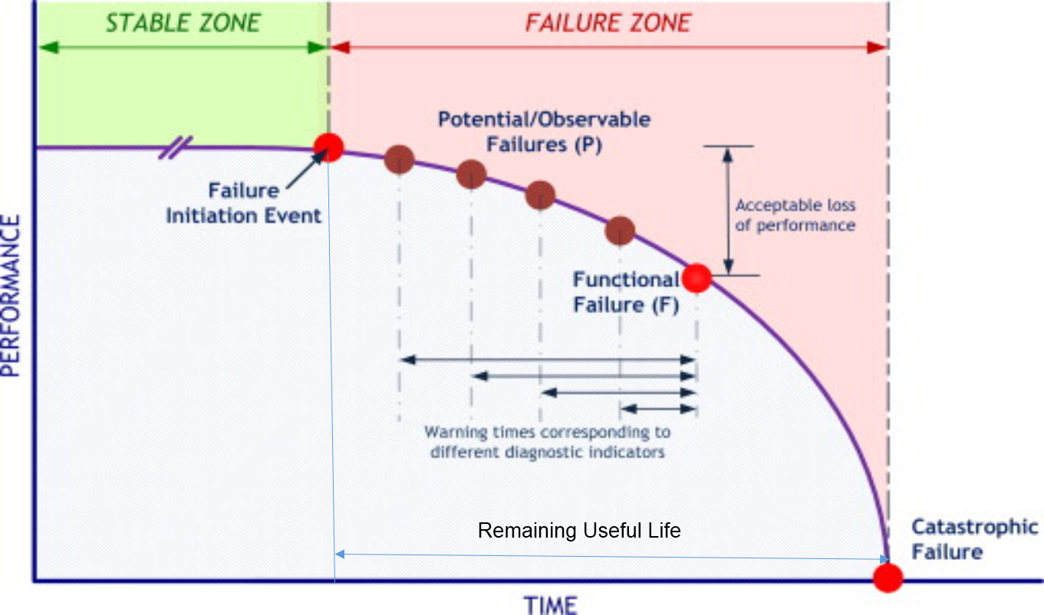
WHAT IS REMAINING USEFUL LIFE ?
Subir Chowdhury School of Quality and Reliability
Useful life is an estimated time that an asset is expected to continue to serve its intended function.
Remaining Useful Life is time taken by the unit to reach a failure condition from a current healthy condition.
RUL can be expressed in years, cycles, miles etc.

Slide 23
OBJECTIVE
Subir Chowdhury School of Quality and Reliability
Accurate and fast estimation of the Remaining Useful Life (RUL) of a turbofan engine under study using data driven methodology.

Slide 24
LITERATURE REVIEW
Subir Chowdhury School of Quality and Reliability
Similarity based approach
Wiener Process based approach
Neural Net based approach
Stochastic approach

Slide 25
SIMILARITY BASED APPROACH
Subir Chowdhury School of Quality and Reliability
Winning paper of PHM 08 Challenge.
Step1 : Partitioning of training data into operating regimes.
Step2 : Linear regression based Health Index having range between 0 to 1 was formed for each operating regime.
Step 3 : Degradation model based on exponential distribution was built by fitting a curve of the HIs vs time cycle.

Slide 26
SIMILARITY BASED APPROACH
Subir Chowdhury School of Quality and Reliability
Step 4 : Parameters of model was calculated for each unit in training set.
Step 5 : The essential element of the similarity method was to seek the most similar degradation model. The similarity between testing unit and degradation model for each unit was defined by Euclidean distance. Euclidean distance was calculated between testing unit and the training unit data points.
Step 6 : RUL was the minimum of summation of Euclidean distance calculated in the last step.

Slide 27
SIMILARITY BASED APPROACH
Subir Chowdhury School of Quality and Reliability
Limitations
Selection of sensors was done only on the basis of consistency in the trend.
Technique implemented for similarity measurement was Euclidean distance. Other similarity measures may give better result.
Linear regression based modelling was used for health index formation.
Other than exponential distribution, no distribution was tested for deriving a degradation model.

Slide 28
WIENER PROCESS BASED APPROACH
Subir Chowdhury School of Quality and Reliability
Step 1 : Data visualisation using PCA. Only 7 sensors data values were used for the analysis.
Step 2 : First two Principal components were taken to modify sensor data values for each time cycle based on histogram of variance.
Step 3 : Projections of last time cycle data values of each training unit was used to create a failure space in the plot between PC1 and PC2.
Step 4 : The new observed data from the test unit was projected onto the plot between two principal components.

Slide 29
WIENER PROCESS BASED APPROACH
Subir Chowdhury School of Quality and Reliability
Step 5 : Health Index which is Euclidean distance between projections of observed data and barycentre of the failure space was calculated.
Step 6 : Considering the distance between two successive HIs as random, Wiener process was used to model the degradation path.
Step 7: Parameters of Wiener process was estimated using MLE.
Step 8 : Degradation path of test unit was simulated using Monte-Carlo method. Final RUL was the empirical mean of all predicted RULs in the simulated degradation path.

Slide 30
WIENER PROCESS BASED APPROACH
Subir Chowdhury School of Quality and Reliability
Limitations
PC were derived using only 7 sensors.
Wiener process is inadequate in modelling degradation which is monotone.
Wiener process is a time homogenous process but not all degradation process has this property.
Wiener process does not take into account the path taken during degradation which has significant bearing on the estimated RUL.

Slide 31
NEURAL NETWORK BASED APPROACH
Subir Chowdhury School of Quality and Reliability
Step 1 : Data visualisation was done with an aim to understand the data. Techniques used were PCA, Self Organising map, Sammon mapping and Neuroscale mapping. Neuroscale mapping was finally used in this step.
Step 2 : Sensor data was normalised to provide common scale across all sensor values.
Step 3 : Complete normalised sensor data along with the operational settings was used to find RUL. Techniques used were Multi Layer Perceptron and Radial Basis function.

Slide 32
NEURAL NETWORK BASED APPROACH
Subir Chowdhury School of Quality and Reliability
Step 4 : Kalman filter was used to improve the results as variation was found between actual RUL and predicted RUL for training set.
Step 5 : Ensembling was done to further improve the results.
Limitations
RUL vs Life scale plot was found to be linear. Linear model cannot trace the dynamics of degradation process completely.

Slide 33
NEURAL NETWORK BASED APPROACH
Subir Chowdhury School of Quality and Reliability
Limitations
Final RUL Predictions came out be either over or underestimate on a per unit basis.
Kalman filter tuning which can further improve the results was not tried.
No attempt was made to select the best sensors. This has increased the computational complexity.

Slide 34
RECURRENT NEURAL NETWORK BASED APPROACH
Subir Chowdhury School of Quality and Reliability
Step 1 : Complete sensor data along with the operational settings was used to find RUL. Technique used was Multi Layer Perceptron with extended Kalman Filter.
Step 2 : For better results RNN model was used for estimating the RUL.
Step 3 : For optimising the neural net, Differential evolution was used for RNN model.

Slide 35
RECURRENT NEURAL NETWORK BASED APPROACH
Subir Chowdhury School of Quality and Reliability
Limitations
Justification for selecting first 30 sensor reading as healthy state and last 30 as failure state was not given.
Estimates of RUL were fairly good when the RUL is less than 55. However difference was large for larger estimates of RUL.
RNN has increased the complexity by two fold as compared to MLP.

Slide 36
STOCHASTIC APPROACH
Subir Chowdhury School of Quality and Reliability
Based on the assumption that time to failure of similar system is independent and identical random variable and thus can be explained by a PDF.
Weibull distribution was used as a lifetime distribution model.
Failure times of the training set were used to fit a cumulative distribution function.
Parameters of the Weibull distribution were then calculated.

Slide 37
STOCHASTIC APPROACH
Subir Chowdhury School of Quality and Reliability
RUL was estimated using expression of Mean residual life.
Limitations
Poor score
Does not takes into account the progressive degradation phenomena that leads to failure.

Slide 38
PROPOSED METHODOLOGY
Subir Chowdhury School of Quality and Reliability
Preliminary Data Analysis Significant features representing direct relation with the health are selected.
Health Index Relation between measured features and the health of the system is established.
Degradation Model Based on HI, the degradation model depicting the complete life of the system is derived.
RUL Prediction
Evaluation Results are evaluated based on evaluation metrics.

Slide 39


Slide 40
CATEGORY 2
Subir Chowdhury School of Quality and Reliability
Based on estimation of two mapping function.
Step 1 : First function maps sensor measurements to 1 –D health index. Linear regression, SPR etc
Step 2 : Second function links health index values to RUL
A library of degradation models is constructed

Slide 41
CATEGORY 3
Subir Chowdhury School of Quality and Reliability
Step 1 : Sensor measurements trajectory labelled with known failure times are used to create a library.
Step 2 : Mapping between RUL and feature vectors
Step 3 :

